Slide 1
Diffie-Hellman key exchange algorithm Computer and network security Group 4

Slide 2
Outline
Define Diffie and Helman
History of the Algorithm
Application area of the algorithm
Mathematical expressions and steps
Drawback of the algorithm
sources for further reading

Slide 3
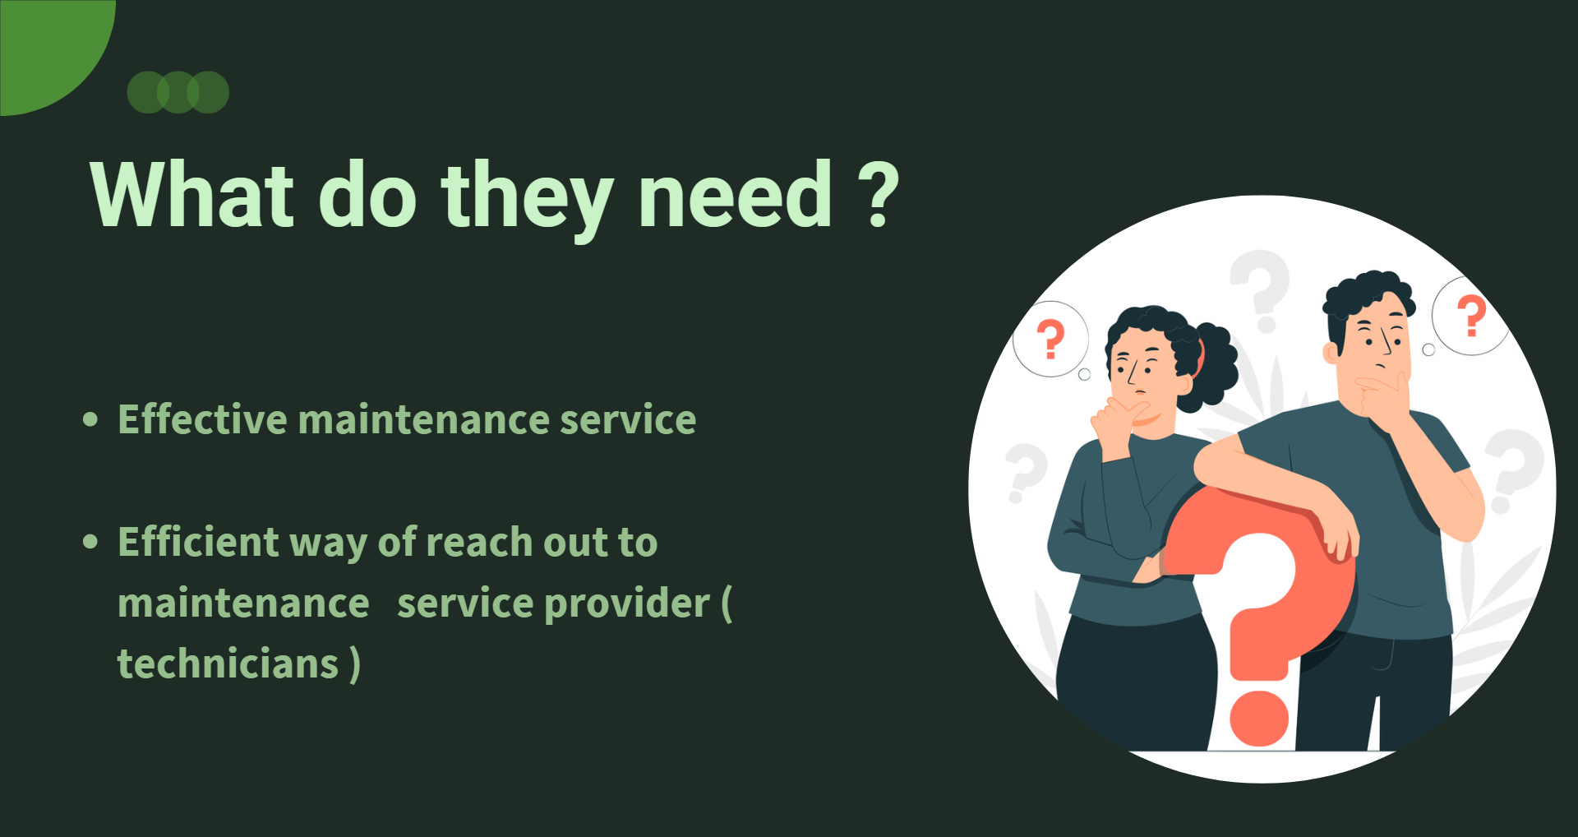
How can you securely share a symmetric key over a communication channel that isn't secure?

Slide 4
Diffie and Helman

Slide 5
INTRODUCTION
Diffie–Hellman key exchange is a mathematical method of securely exchanging cryptographic keys over a public channel and was one of the first public-key protocols as conceived by Ralph Merkle and named after Whitfield Diffie and Martin Hellman.
The Diffie–Hellman key exchange method allows two parties that have no prior knowledge of each other to jointly establish a shared secret key over an insecure channel.
Diffie-Hellman key exchange is a method of digital encryption that securely exchanges cryptographic keys between two parties over a public channel without their conversation being transmitted over the internet.
It was one of the first practical examples of public key cryptography.
The method doesn't share information during the key exchange. The two parties have no prior knowledge of each other, but the two parties create a key together.
This key can then be used to encrypt subsequent communications using a symmetric-key cipher.
An analogy illustrates the concept of public key exchange by using colors instead of very large numbers

Slide 6
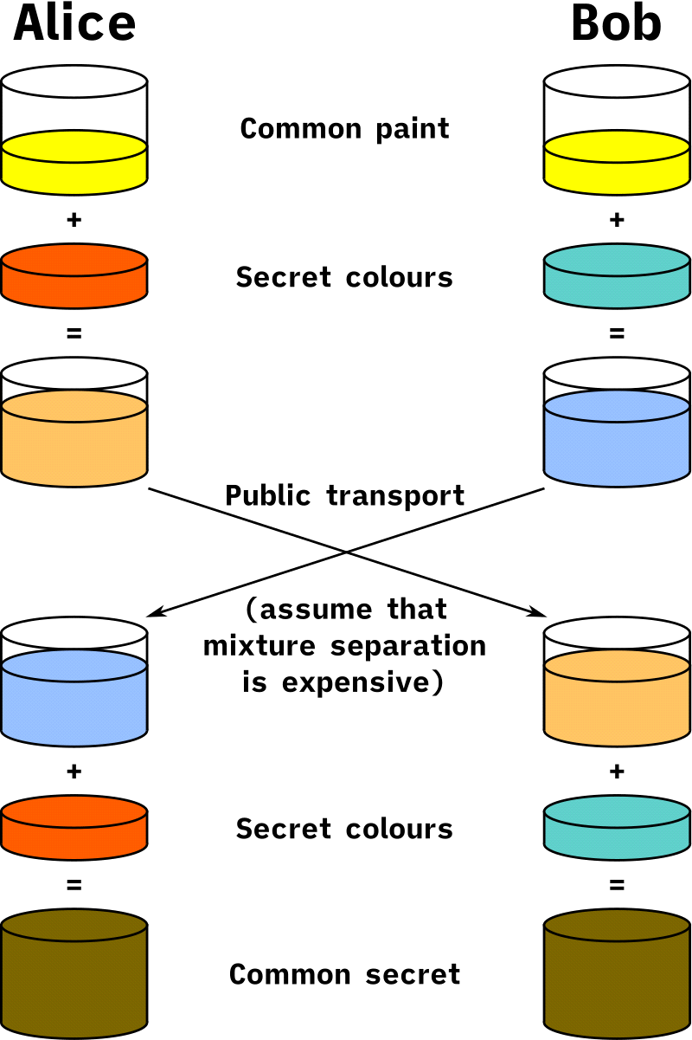
HOW IT WORKS

Slide 7
HOW IT WORKS
The process begins by having the two parties, Alice and Bob, publicly agree on an arbitrary starting color that does not need to be kept secret. In this example, the color is yellow. Each person also selects a secret color that they keep to themselves – in this case, red and cyan. The crucial part of the process is that Alice and Bob each mix their own secret color together with their mutually shared color, resulting in orange-tan and light-blue mixtures respectively, and then publicly exchange the two mixed colors. Finally, each of them mixes the color they received from the partner with their own private color. The result is a final color mixture (yellow-brown in this case) that is identical to their partner's final color mixture.
If a third party listened to the exchange, they would only know the common color (yellow) and the first mixed colors (orange-tan and light-blue), but it would be very hard for them to find out the final secret color (yellow-brown). Bringing the analogy back to a real-life exchange using large numbers rather than colors, this determination is computationally expensive. It is impossible to compute in a practical amount of time even for modern supercomputers.

Slide 8
Cryptographic explanation
To implement Diffie-Hellman, two end users, Alice and Bob, mutually agree on positive whole numbers p and q, such that p is a prime number and q is a generator of p. The generator q is a number that, when raised to positive whole-number powers less than p, never produces the same result for any two such whole numbers. The value of p may be large, but the value of q is usually small.
Once Alice and Bob have agreed on p and q in private, they choose positive whole-number personal keys a and b. Both are less than the prime number modulus p. Neither user divulges their personal key to anyone; ideally, they memorize these numbers and don't write them down or store them anywhere. Next, Alice and Bob compute public keys a* and b* based on their personal keys according to the following formulas:
a* = qa mod p
b* = qb mod p
The two users can share their public keys a* and b* over a communications medium assumed to be insecure, such as the internet or a corporate wide area network. From these public keys, a number x can be generated by either user on the basis of their own personal keys. Alice computes x using the following formula:
x = (b*) mod p
Bob computes x using the following formula: x = (a*) mod p

Slide 9
Cryptographic explanation
1.Alice and Bob publicly agree to use a modulus p = 23 and base g = 5 (which is a primitive root modulo 23).
2.Alice chooses a secret integer a = 4, then sends Bob A = ga mod p
3. A = 54 mod 23 = 4 (in this example both A and a have the same value 4, but this is usually not the case)
4. Bob chooses a secret integer b = 3, then sends Alice B = gb mod p
B = 53 mod 23 = 10
5.Alice computes s = Ba mod p
s = 104 mod 23 = 18
6. Bob computes s = Ab mod p
s = 43 mod 23 = 18
Alice and Bob now share a secret (the number 18).

Slide 10
WHERE IS THE DIFFIE HELMAN KEY EXCHANGE USED
Diffie-Hellman key exchange's goal is to securely establish a channel to create and share a key for symmetric key algorithms. Generally, it's used for:
Encryption: The Diffie Hellman key exchange algorithm can be used to encrypt; one of the first schemes to do is ElGamal encryption. One modern example of it is called Integrated Encryption Scheme, which provides security against chosen plain text and chosen clipboard attacks.
Password Authenticated Agreement: When two parties share a password, a password-authenticated key agreement can be used to prevent the Man in the middle attack. This key Agreement can be in the form of Diffie-Hellman. Secure Remote Password Protocol is a good example that is based on this technique.It is used to prevent man-in-the-middle (MitM) attacks.
Forward Secrecy: Forward secrecy-based protocols can generate new key pairs for each new session, and they can automatically discard them when the session is finished. In these forward Secrecy protocols, more often than not, the Diffie Hellman key exchange is used.It protect against the compromising of keys by generating new key pairs for each session.
Diffie-Hellman key exchange is commonly found in security protocols, such as Transport Layer Security (TLS), Secure Shell (SSH) and IP Security (IPsec). For example, in IPsec, the encryption method is used for key generation and key rotation.

Slide 11
Vulnerabilities of Diffie-Hellman key exchange
The most serious limitation of Diffie-Hellman in its basic form is the lack of authentication. Communications using Diffie-Hellman by itself are vulnerable to MitM. Ideally, Diffie-Hellman should be used in conjunction with a recognized authentication method, such as digital signatures, to verify the identities of the users over the public communications medium.
Diffie-Hellman key exchange is also vulnerable to logjam attacks, specifically against the TLS protocol. Logjam attacks downgrade TLS connections to 512-bit cryptography, enabling an attacker to read and modify data that's passed through the connection. Diffie-Hellman key exchange can still be secure if implemented correctly. For example, logjam attacks won't work with a 2,048-bit key.

Slide 12
Examples of Diffie-Hellman key exchange
If two people, say Alice and Bob, want to communicate sensitive data over an open public network but want to avoid hackers or eavesdroppers, they can use Diffie-Hellman key exchange method for encryption. This open public network could be at a cafe, for example Alice and Bob privately choose a secret key, and a function is run on these keys to create a public key. The results and not the function are shared. Even if a third party is listening in, that third party won't have all the involved numbers, making it difficult to derive the function the numbers came from.From here, Alice and Bob each run a new function using the results they received from the opposite party, their own secret number and the original prime value. Alice and Bob then arrive at a common shared secret key that a third party can't deduce. Alice and Bob are now free to communicate without worrying about third parties.

Slide 13
Advantages of the Diffie Hellman Algorithm
The sender and receiver don’t need any prior knowledge of each other.
Once the keys are exchanged, the communication of data can be done through an insecure channel.
The sharing of the secret key is safe.

Slide 14
Disadvantages of the Diffie Hellman Algorithm
The algorithm can not be sued for any asymmetric key exchange.
Similarly, it can not be used for signing digital signatures.
Since it doesn’t authenticate any party in the transmission, the Diffie Hellman key exchange is susceptible to a man-in-the-middle attack.

Slide 15
CONCLUSION
Diffie Hellman key Exchange has proved to be a useful key exchange system due to its advantages. While it is really tough for someone snooping the network to decrypt the data and get the keys, it is still possible if the numbers generated are not entirely random. Also, the key exchange system makes it possible to do a man in the middle attack; to avoid it, both parties should be very careful at the beginning of the exchange.

